Slide 1
VLSI System Design Final Project Demo
107065507 盧允凡

Slide 2
Outline
RSA
First approach
Second approach
FSM
Block Diagram
Cycles Analysis
Simulations

Slide 3
RSA Engine
KEY: E, D, and N
Input data: A
All 2048-bit
Using LR algorithm to compute A**E (mod N)

Slide 4
First Approach
RTL simulation passed, but synthesis failed.
the multiplier is too big!!!
2048-bit x 2048-bit
Second Approach
Using word-based design to do the multiplication.
multiplication fixed, but modulo is still unsolved.
RTL simulation passed, but synthesis failed.

Slide 5
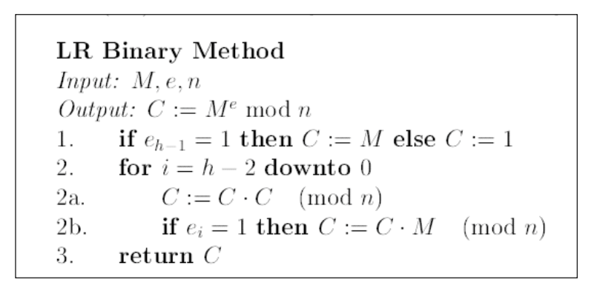
LR algorithm

Slide 6
FSM
x64*3
IDLE
KEY_E
&
KEY_D
&
KEY_N
DONE
x64
DATA_FEED
x64
O(2048)
OUTPUT
LR_1
Find the msb
64x64
x64
If statement in LR
LR_2_MUL
LR_3
RELOAD
Word-based multi
RELOAD
LR_4
LR_4_MUL
x64
Word-based multi
64x64

Slide 7
Block Diagram
clk
rst_n
testbench
32
result
exe
mode
oe_n
filter
addr
8
status
wen
done
32
SRAM
32x256
data

Slide 8
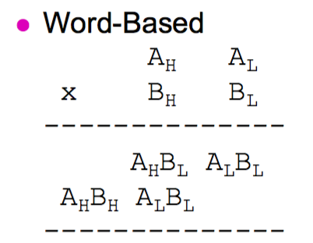
Word-based multiplication
Split 2048-bit into 64 x 32-bit.
require 64*64 cycles to complete the computation.

Slide 9
Cycles Analysis
Input key: 3*64
N data feeding: N*64
LR algorithm: N*(O(2048)*64*64+64)
Output: N*64

Slide 10
SRAM area estimation
The area of a single-port 32*256 SRAM is 43400 um2.

Slide 11
Simulations
Example 1
Public key: (E, N) = (7, 143)
Message = 03 08 23 01 14 07

Slide 12
Simulations
Example 1
Private key: (D, N) = (103, 143)
Message = 42 57 23 01 53 06

Slide 13
Simulations
Example 2
(E, N) = (157, 2773)
Message = 948

